Slide 1
Physics 3 – Nov 21, 2019
P3 Challenge –
  What is the electric field (magnitude and direction) located exactly halfway between a positive charge of 1.30 C and a negative charge of 6.20 C separated by 15.0 cm?
Get out 5.1 #1-9 for HMK check

Slide 2
Physics 3 – Nov 21, 2019
Objective:
  5.1 Electrostatics, cont
Assignment:
    p205 #10-14
Agenda:
  Current
  Electron drift
  Potential difference

Slide 3
Current
Moving charges within a medium creates a current.
Current is measured as a rate of transfer of charge per time.
Symbol: I Unit: Ampere, A 1 A = 1 C/s (SI base unit)
1) Positive charge moves in the opposite direction as electrons
2) A charge can move faster than actual matter can move.
3) The only thing that physically moves to transfer charge is the electron. Positive charge is the absence of an electron.
Q = I t Demo dancing everyone!

Slide 4
Electron Drift
So how fast do the electrons actually move? = Electron drift, v
Distance across a given segment of wire = vt
The volume of the cross section is the cross sectional area A times the length or = Avt
If there are n electrons in a given volume (#electrons/m³), the number of electrons in the volume is = nAvt
Q is created by n electrons, each with q charge, so Q = nqAvt
Current is the charge that passes in a given time I = Q/t I = nqAvt/t
  I = nqAv I = current, n = number of e/m³
  v = electron drift speed A = cross sectional area of the wire

Slide 5
Electron Drift calculation
How fast are electrons moving in a copper wire with a diameter of 1.5 mm when a current of 0.350 A is applied?
Density of copper is 8.96 g/cm³. (Assume about 10 electrons per copper atom are available for metallic bonding.)
Compare this to the speed of charge on the wire which travels at the speed of light, nearly instantaneous.

Slide 6
Electric Potential Energy
The electric force is a conservative force so there is a potential energy that corresponds to the opposite of the work done by the conservative force.
Thought Experiment 1:
Consider a tiny positive test charge is infinitely far away from an isolated positive charge at the origin. This has 0 electric potential energy. (No force)
As the charge moves closer to the charge (-x) , it is more and more repelled and the electric force (+F) is doing negative work. The charge therefore is experiencing a positive potential energy change.
  Positive charges are at a high potential energy for a positive test charge
  Analogy to a marble at the top of a hill.

Slide 7
Electric Potential Energy
Thought Experiment 2:
Consider a tiny positive test charge is infinitely far away from an isolated negative charge at the origin. This also has 0 electric potential energy. (No force)
As the charge moves closer to the charge (-x) , it is more and more repelled and the electric force (-F) is doing positive work. The charge therefore is experiencing a negative potential energy change.
  Negative charges are at a low potential energy for a positive test charge
  Analogy to a marble at the bottom of a valley

Slide 8
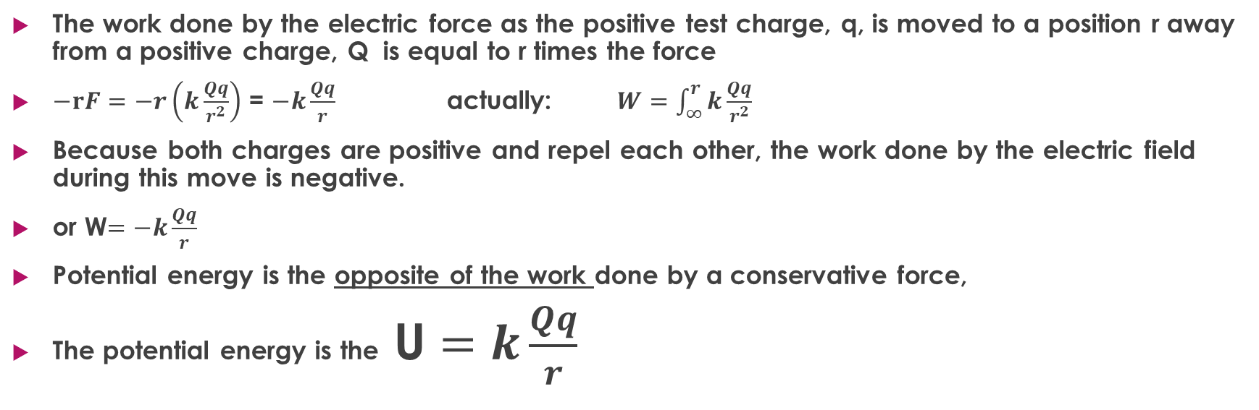
Electric Potential Energy
The work done by the electric force as the positive test charge, q, is moved to a position r away from a positive charge, Q is equal to r times the force
$−rF=−r\left(k\frac{Qq}{r^{2}}\right)$ = $−k\frac{Qq}{r}$ actually: $W=\int_{∞}^{r}{k\frac{Qq}{r^{2}}}$
Because both charges are positive and repel each other, the work done by the electric field during this move is negative.
or W$=−k\frac{Qq}{r}$
Potential energy is the opposite of the work done by a conservative force,
The potential energy is the U $=k\frac{Qq}{r}$

Slide 9
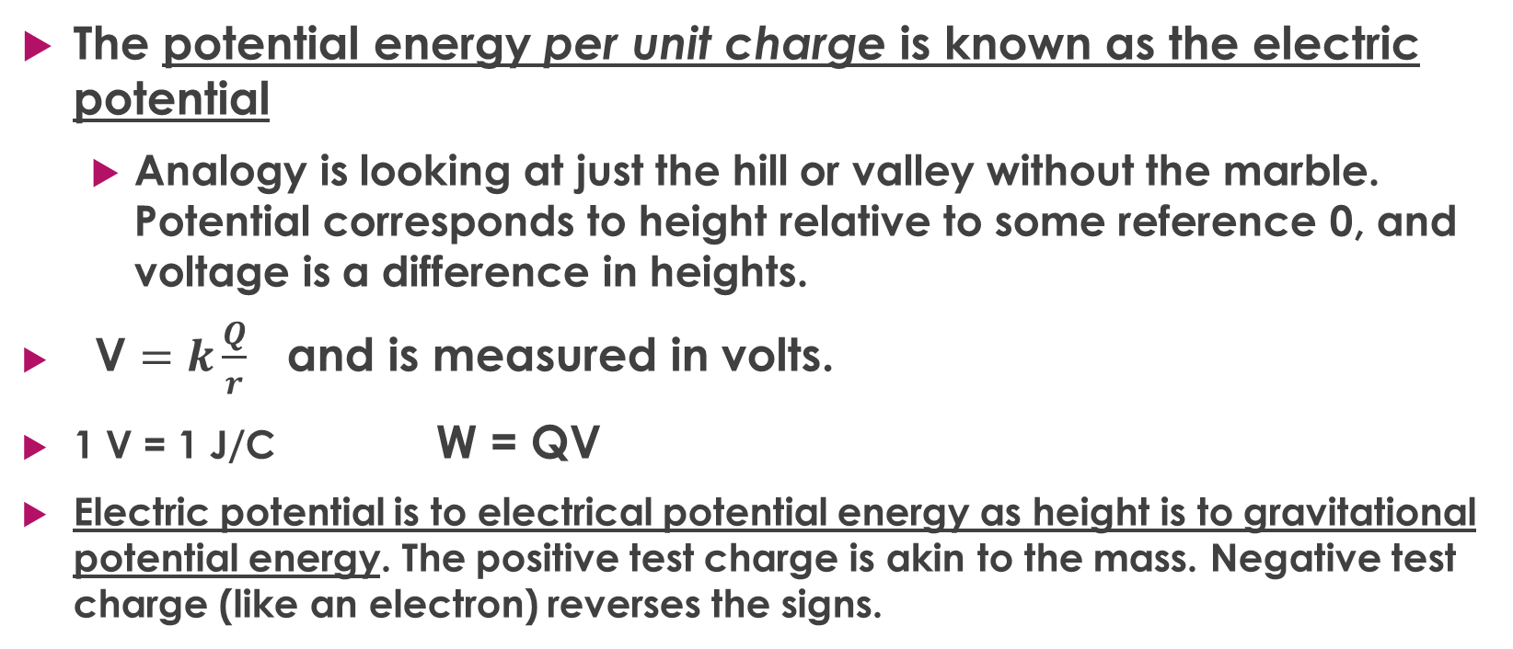
Electric potential
The potential energy per unit charge is known as the electric potential
  Analogy is looking at just the hill or valley without the marble. Potential corresponds to height relative to some reference 0, and voltage is a difference in heights.
V $=k\frac{Q}{r}$ and is measured in volts.
1 V = 1 J/C W = QV
Electric potential is to electrical potential energy as height is to gravitational potential energy. The positive test charge is akin to the mass. Negative test charge (like an electron) reverses the signs.

Slide 10
Electric potential
Positive charges create a relative high potential state.
Negative charges create a relative low potential state.
Moving from a lower to a high potential is a positive voltage.
Just like height, the word potential can refer to both a fixed state and a difference in states.
Wherever there is an electric field there will be a potential difference.
https://www.youtube.com/watch?v=m4jzgqZu-4s Watch first 15 seconds.

Slide 11
The electron Volt (eV)
Because electrons are so small, the associated energies are very small, much smaller than a J.
1 eV is the energy of one electron charge over 1 volt
1 eV = (1.6 x 10⁻¹⁹ C) (1 J/C)
1 eV = 1.6 x 10⁻¹⁹ J
If you get a very small amount of energy, convert to eV. Or you may be given information in eV.

Slide 12
Exit slip and homework
Exit Slip – What is the electron drift speed for a 1.25 mm diameter aluminum wire carrying a 230 mA current? The density of Aluminum is 2.70 g/cm³, the molar mass of Aluminum is 27 amu, and 3 electrons per Al atom are available for metallic bonding.
  What’s due? (homework for a homework check next class)
    P205 # 10-14
  What’s next? (What to read to prepare for the next class)
    Read 5.2 p 207-226

